Slide 1
Credit Architecture Project Phase 2 Discussion on End-to-End Process Section A – Main Deck

Slide 2




Agenda
Recap: Objectives, Pain Points & Guiding Principles
Approach for “To-Be” Process
Walkthrough of Use Cases
Next Steps

Slide 3
Recap – Progress update after 28 Aug & 27 Oct PSCs
Process Flow and Activities: Further Drill Down
Map out activities for “As-Is” and "To-Be” for the 10-step Credit Process
Develop Use Cases for proof of concept of the activities
Quantification of Costs and Benefits
Approach for Cost-Benefit Model presented by Finance
Develop the Cost-Benefit Model (Baseline vs. Target)
Challenge and validate the Baseline, Target and Benefits with senior management from IBG, RMG and T&O

Slide 4

Recap – Credit ecosystem, jobs to be done
Customers are at the center of
everything we do in IBG
Quick TAT for credit approval/ activation/ disbursement
Simple documentation
Superior client service and experience (incl. single point of contact, first call resolution on issues, simple digital platforms)
Apprised of status of loan activities
Competitive pricing
Innovative and relevant financing solutions through credit structuring
IBG-RM – Increase focus and capacity for marketing, account planning and client engagement
Simplified e2e credit processes, esp. for Targeting, Origination, Underwriting and Monitoring
Single point of system access, linked across key systems with EOD view of client information (financials, risk parameters, account plans) in an easy and intuitive platform with mobile capabilities.
Minimize the need for data input; rely on auto-population (e.g. auto-populated financials from MRA into credit memo)
Single point of input for data with seamless data flow across systems
Automation of rule validation and exception alerts
Simplified documentation and associated process
Auto-notification upon quantitative triggers
Easy facility maintenance and update
RMG-CRM – Enable the CRMs to analyze, underwrite and monitor risk in an effective and efficient manner
Easy access, EOD view of Group exposure, utilization trend, account conduct.
Auto-notification upon quantitative triggers (e.g. DPD, limit excesses or overdue reviews)
Reduce reliance on CRMs checks for Credit Memos through single source inputs and automation (e.g. auto-populated financials from MRA into credit memo, system prompts/ rule checks on key policies and guidelines)
RMG-CCU – Enable effective risk control through efficient automated monitoring processes
Improvement in TAT for activation with STP to operating systems (e.g. Finacle, MLC)
Simplified documentation and associated process
Auto-generation of risk monitoring reports with auto-alerts (e.g. covenant tracking, limit expiry, group reviews)
More efficient and consistent safe-keeping tool (e.g. central document imaging system) with user friendly search
Easy facility maintenance and update
RMG-RI/ GPA – Enable portfolio insights through analytics and stress test
Improve accuracy of risk reporting through upstream streamline of process and systems which will lead to better credit decision. This includes single source of data input, identification of golden source, common facility structure across Finacle instances, data linkage across systems.
Auto-generation of Credit MIS Reports
Increase scalability of stress tests via automation, including catering for multiple factors and scenarios
IBG-Ops – Faster loan disbursement through
Less sequential steps on limit activation and loans processing
Near real time STP between Finacle-IPE
Easy facility maintenance and update
IBG5/ GSAM – Enable effective restructuring and recovery efforts through efficient automated monitoring processes
Accurate and timely delivery of Watchlist data, with tagging at source
Auto-tagging and notification upon quantitative triggers (e.g. DPD, limit excesses or overdue reviews)
Timely recognition of NPL and to reflect correct income recognition by automating downgrade based on DPD exceeding 90 days and auto suspension of interest
Minimize manual computation by having system to reflect both the borrowers actual liabilities vs. GL
Uniform workbench to capture SP forecast at source and automatically reflect consolidated numbers

Slide 5
Recap – Key pain points (1/ 4)
I.
Client Targeting
II.
Credit Origination
III.
Underwriting
IV.
LO Issuance
V.
Client Consideration
VI.
Facility Onboarding
VII.
Facility Utilization
VIII.
Risk Monitoring
IX.
Remediation
X.
Facility Discharge
Process Step | Pain Point/ Gap
I. Client Targeting | Screening customers is based on manual records & checklists e.g. TMRAC, conduct of A/ C, previous rejections Changes in GCIN need to be manually synchronized downstream
II. Credit Origination | Manual computations e.g. aggregation of exposures, DOA determination Lacks routing flexibility e.g. break the work into smaller chunks that can be delegated, simultaneous access Unable to support the requirements of the “Top-Down” credit approach Users have to manually track upcoming tasks & notify each other
III. Underwriting | Extensive manual checks required to ensure the quality of submission Difficulty in identifying the changes hampers efficient review
IV. Letter of Offer | LOs have to be manually generated and require repeating the data already provided

Slide 6
Recap – Key pain points (2/ 4)
I.
Client Targeting
II.
Credit Origination
III.
Underwriting
IV.
LO Issuance
V.
Client Consideration
VI.
Facility Onboarding
VII.
Facility Utilization
VIII.
Risk Monitoring
IX.
Remediation
X.
Facility Discharge
Process Step | Pain Point/ Gap
VI. Facility Onboarding | Spreadsheets/ UDMA are used for tracking Sup Rev date, covenants, insurance, limit expiry LTV, FQ re-margining are manually adjusted in the system Many reminder emails for different deadlines and overdues are sent out to RMs Excess management for real time ad-hoc transaction is manual outside of Spore Auto population of common data from Master source to downstream system was usually not in scope/ “silo scope” for system implementation resulting in duplicate fields in different systems. No agreed Master source causing downstream reporting problems when upstream data incorrect Multiple registers maintained on Spreadsheet which is high Operation Risks Indexing of soft copies are stored on LAN drive which is not user friendly for searches and viewing No linkage to the operating system/ application facility line for easy online tracking
VII. Facility Utilization | No parallel processing (sequential loans creation/ disbursement after limit activation) and no STP between Finacle and IPE, leading to long TAT for disbursement and limited ability for capacity load balancing

Slide 7
Recap – Key pain points (3/ 4)
I.
Client Targeting
II.
Credit Origination
III.
Underwriting
IV.
LO Issuance
V.
Client Consideration
VI.
Facility Onboarding
VII.
Facility Utilization
VIII.
Risk Monitoring
IX.
Remediation
X.
Facility Discharge
Process Step | Pain Point/ Gap
VIII. Risk Monitoring | Group Review IBG RM with CSO support to manually compile information (by accessing various systems) before submission to CRMs for approval.
 | Early Warning Trigger Various types of triggering events. Upon trigger, RMs need to fill up Pro-AM form (information has to be manually compiled). Watchlist tagging process is manual and update quarterly in system Stress Test After stress test requirements are provided, RMs need to manually download MRA financial information and judgmentally stress the borrower financial to get new ratio. Process of identifying borrowers at risk is manual, and no consistent process/ approach

Slide 8
Recap – Key pain points (4/ 4)
I.
Client Targeting
II.
Credit Origination
III.
Underwriting
IV.
LO Issuance
V.
Client Consideration
VI.
Facility Onboarding
VII.
Facility Utilization
VIII.
Risk Monitoring
IX.
Remediation
X.
Facility Discharge
Process Step | Pain Point/ Gap
IX. Remediation | NPL & Write-off Manual tracking and downgrading of delinquent accounts Suspension of interest for NPL accounts is done manually. Potential oversight may lead to incorrect recognition of income For NPL accounts which are written-off, the Bank’s GL does not reflect the actual liabilities owing by NPL borrowers. Current process is to manually track and compute the actual liabilities owing by NPL borrowers
Generic (applicable to multiple steps) | Data is largely manually input and duplicated across multiple systems and steps Post-Approval changes are required to be performed by the RM User Interface can be enhanced Long lead time to implement policy/ process changes and new products

Slide 9
Recap – Guiding principles for credit e2e (+ DigiBank additions)
Process
Data
Technology
Focus on the customer’s job to be done
Re-imagine, re-design a new customer journey
Instant fulfillment at customer touch point
Eliminate Failure Demand
Single process vision across channels
Empower People to make decision
Create a Single Source of Master Data with consistent definitions and clear ownership
Single point of input/ update
Accessible everywhere
Optimal approval workflow
Data issues fixed at source
Ensure appropriate timeliness of data refresh (intraday, real-time, next day etc.)
Provide traceability of data
Design of data analytics for better automated decision-making and quality of insights
Scalable
Should support volume ramp up at non-linear cost increase
Configurable/ Plug & Play
Should support new credit programmes, client segment etc without code change
Service Oriented
Promote reusability and consistency
Migrate away from big monolithic systems
Standardised
Application stack should be standardized across geographies and client segment
HCD User Interface
Integrated workbench/ single interface for user
Provide Self Service e.g. Reporting
Resilient & Reliable
Cost Efficient

Slide 10
Agenda
Recap: Objectives, Pain Points & Guiding Principles
Approach for “To-Be” Process
Walkthrough of Use Cases
Next Steps

Slide 11
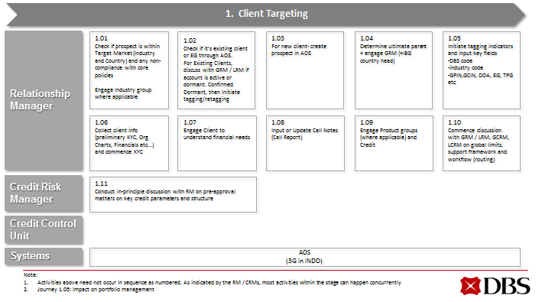
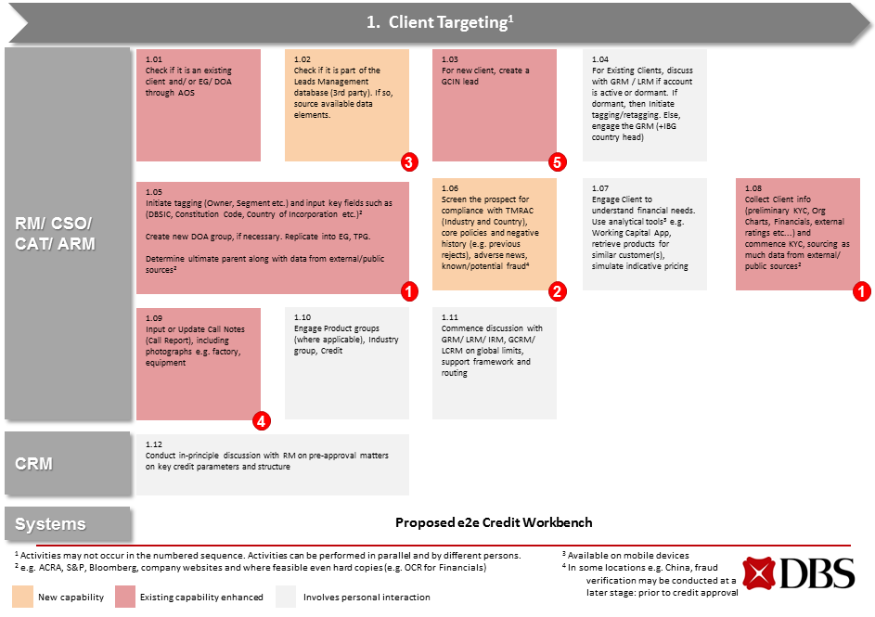
Recap – End-to-end Credit Process
Level 0 – 10-Step Credit Process
I.
Client Targeting
II.
Credit Origination
III.
Underwriting
IV.
LO Issuance
V.
Client Consideration
VI.
Facility Onboarding
VII.
Facility Utilization
VIII.
Risk Monitoring
IX.
Remediation
X.
Facility Discharge
Level 1 – The next level of detailed processes as mapped out in OBEYA and subsequent workshops
“As-Is” Process Map
Presented at OBEYA Jun’14 (part of CAP Phase 1)
“To-Be” Process Map,
Presented at 28 Aug’15 CEO Review
To understand effort and potential benefits, granular details are necessary

Slide 12
Practitioners mapped and analysed “Level 2” processes (incl. roles) with >500 Activities for “As-Is” and “To-Be” states
Level 2 – Activity Analysis
Key Points
Singapore used as the starting point for baseline and benefits due to the scale, variety & complexity of the credit process
Activities analysed at a segment level where appropriate (e.g. differences between IBG 1/ 2 (incl. FI) and 3/ 4 in terms of work done and time taken)
Current exclusions: Senior management (e.g. Sector Heads), IBG Product Teams (e.g. GTS Trade & Product Sales, Project Finance, Syndication Finance), T&M Sales + Ops (for PCE related exposures and CSFA), Central Finance (for regulatory reporting)

Slide 13
We estimated the efforts for “As-Is” and “To-Be” activities
Objectives
Function
Roles in-scope²
Data Collection
Starting with Singapore¹, develop a comprehensive baseline for Effort and Volume across the 10 stage Credit Process as it relates to the IBG business
Derive the required FTE and fully loaded costs (at a role level) validated/ supplied by relevant finance teams
Develop an initial estimate of benefits from process improvements and systems design changes that are contemplated, using a number of levers:
Volume reduction through automation
Reduction in processing time – both on system and off system for clean and rework cases
Improvement in input quality (reduction in rework)
Redistribution of work across roles
IBG
RMs by segment
CSOs by segment
BSU
More than 50 workshops for key stakeholders of e2e credit process to identify all relevant credit activities
Interviews with practioners to collect Effort and Volume information for credit activities identified
Survey results of “Day In the Life Of” RMs
Volume data from internal MIS/ Reporting databases such as OSCA, Finacle, IMEX, MTK
CRMs by segment
CCU
GPA
GSAM
RI
Credit COO
RMG
Operations
Loan Ops
Trade Ops
Technology³
CST

